Slide 1
Zenject & Unity
By Karissa (Ari) Stisser (Software Engineer)

Slide 2
Agenda
Short intro
Basics
Zenject explanation with examples
Demo “Kibble Catch”
Overview of how the demo was made

Slide 3

Karissa Stisser (My Background)
Marine Corps
Standalone software projects
Databases, GUIs, Signal Processing, Image processing, Android, MATLAB… now Unity
Java, Python, Spring, Hibernate, Midas, Ruby, COSMOS, Jenkins, C++, now C#
BS in CS @ UIS
MS in CS @ Georgia Tech

Slide 4
Resources
https://github.com/kstisser/KibbleCatch
https://github.com/modesttree/Zenject

Slide 5
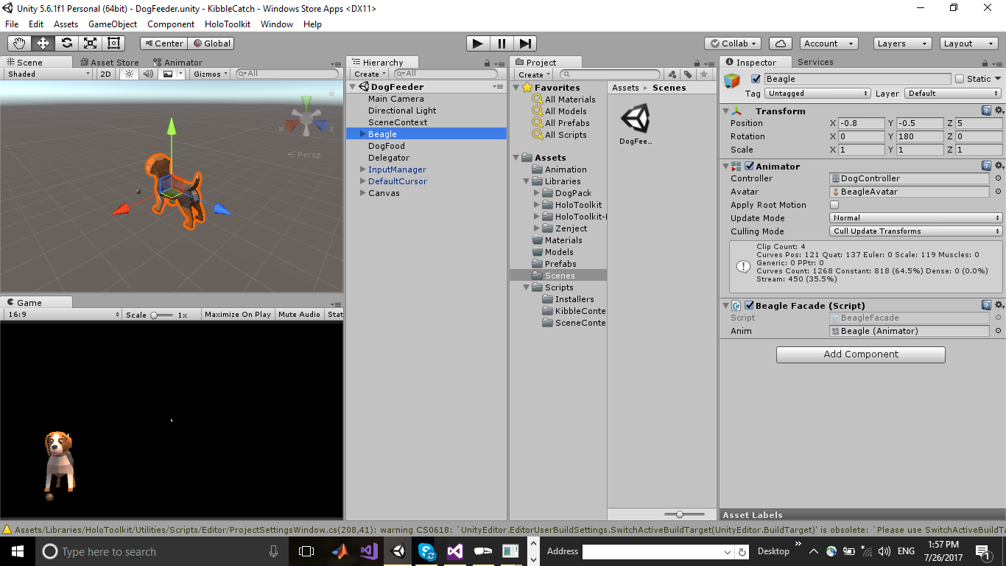
Unity Component Based Architecture
Game Objects
Decoupled/Modular
Readable
Reusable

Slide 6
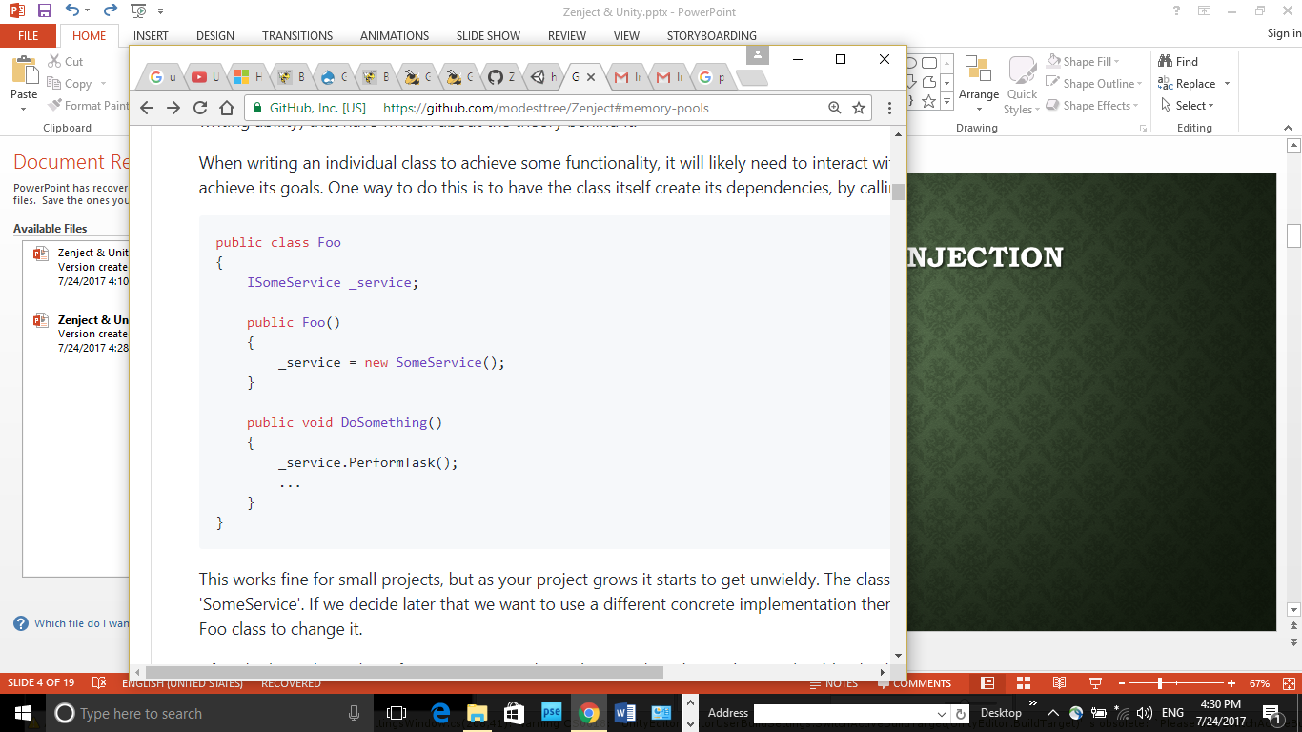
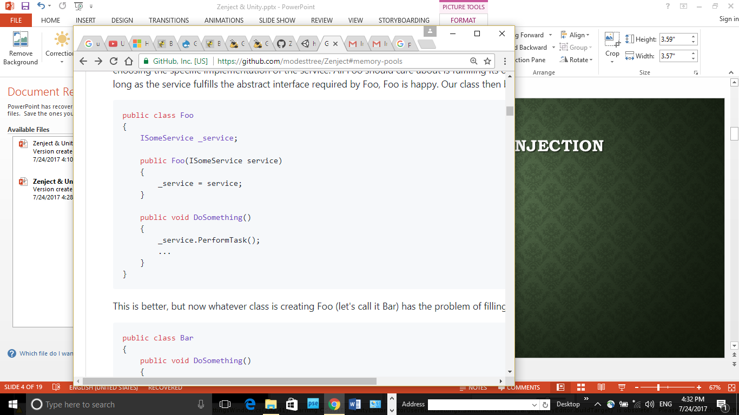
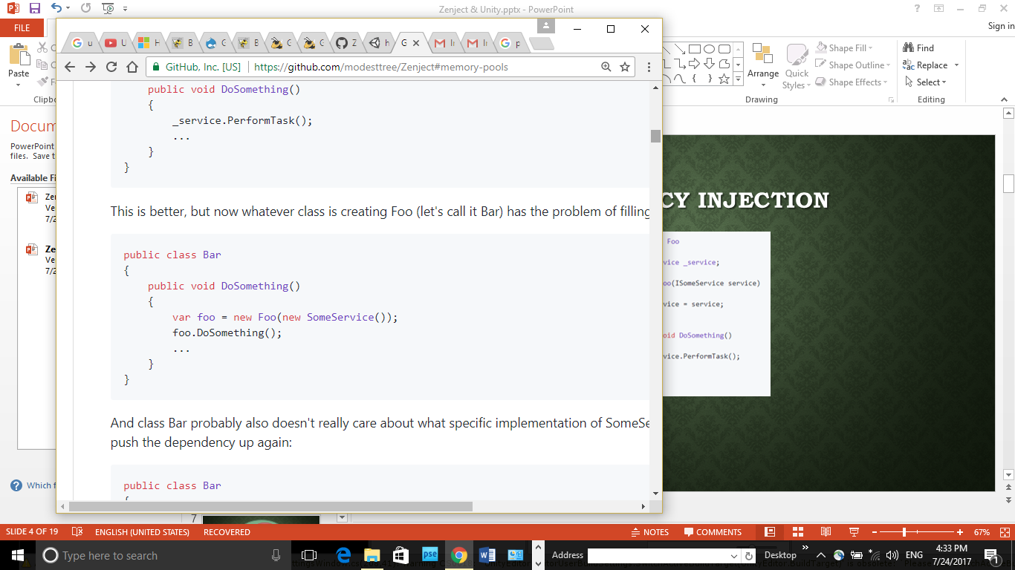
Dependency injection

Slide 7
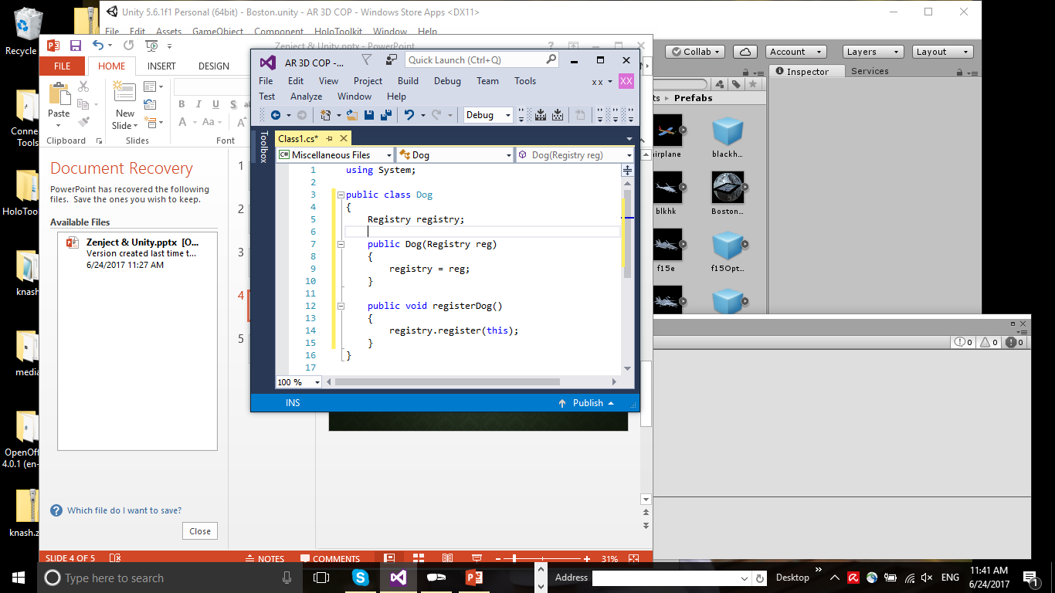
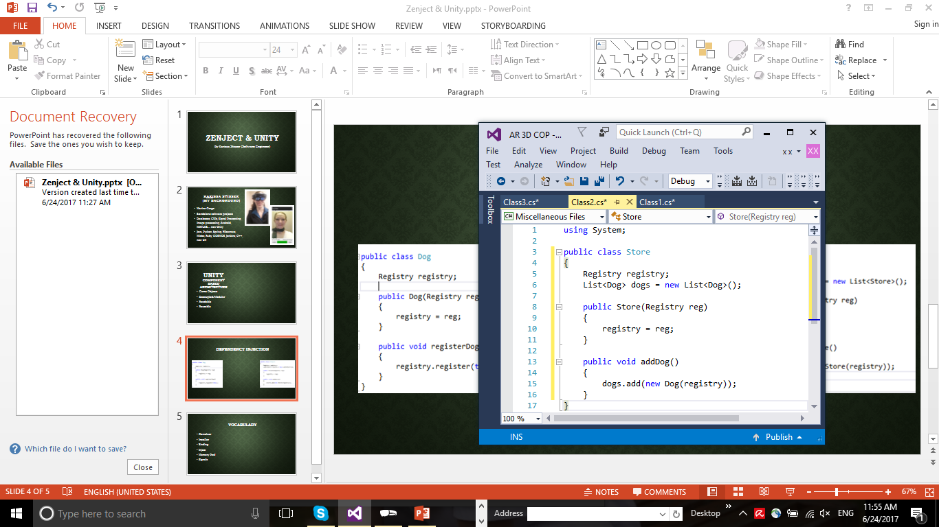
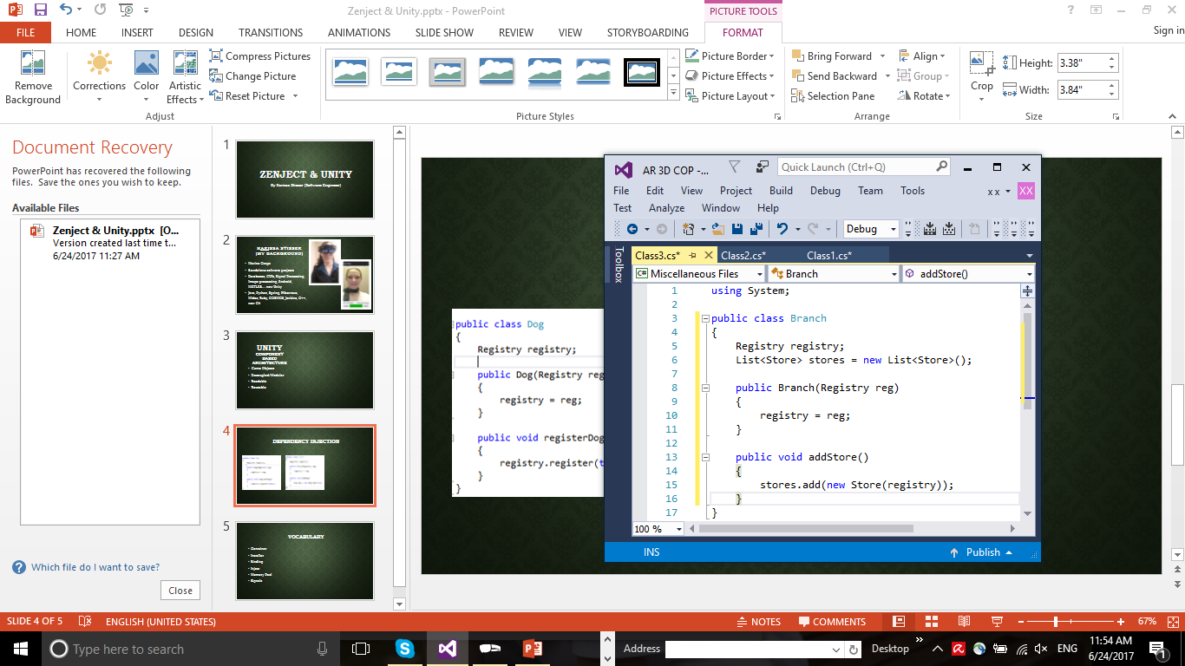
Dependency Injection
Single Purpose
Open/Close principle
Testing

Slide 8
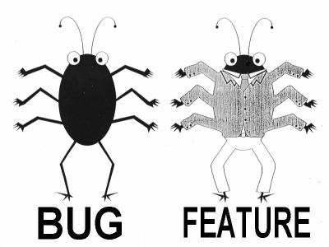

Slide 9

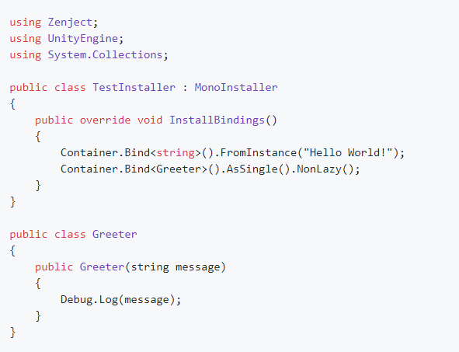
Vocabulary
Container
Installer (script)
Binding
Inject
Signals
Memory Pool

Slide 10
Color Codes
Binding injections in an Installer
Injected values in script
Signals
Memory Pool

Slide 11
Project Context
Scene Context
Game
Context
Game
Context
Game
Context
Scene Context
Game
Context
Game
Context

Slide 12
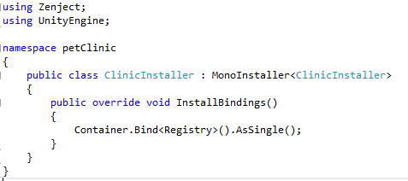
How To Inject
Step 1
Container.Bind<ContractType>()
.To<ResultType>()
.WithId(Identifier)
.FromConstructionMethod()
.AsScope()
.WithArguments(Arguments)
.When(Condition)
.CopyIntoAllSubContainers()
.NonLazy();
.AsCached(), .AsSingle(), .AsTransient()
Bind your dependency in your installer

Slide 13
How To Inject
Step 1 (continued)
Bind your dependency in your installer
Container.Bind<Foo>().AsSingle();
Container.Bind<IBar>().To<Bar>().AsSingle();
Container.BindInstance(“Hello World”);
Container.BindInstance(new Foo()).WhenInjectedInto<ResultType>();
Container.Bind<Foo>().FromMethod(someMethod);
Container.Bind<Bar>().FromFactory<BarFactory>();
Container.Bind<Foo>().FromComponentInNewPrefab(somePrefab);
Container.Bind<Foo>().FromNewComponentOnNewGameObject();
Container.Bind<Foo>().FromComponentInChildren();
Container.BindInterfacesAndSelfTo<Foo>().AsSingle();

Slide 14
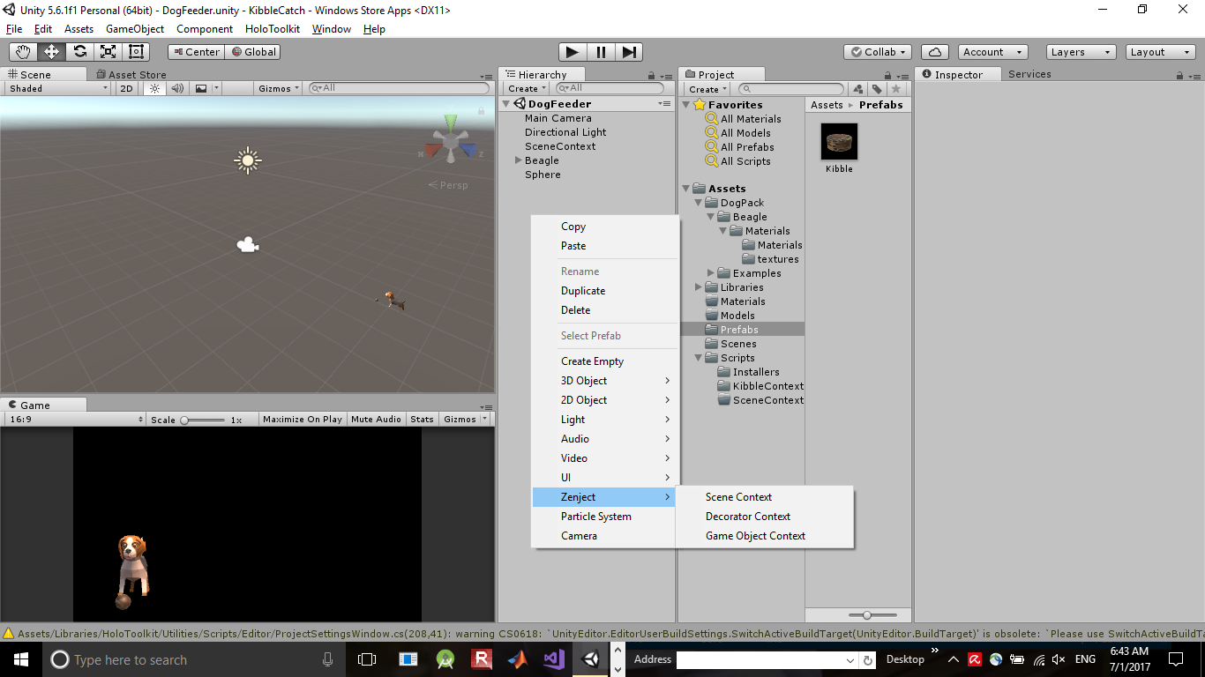
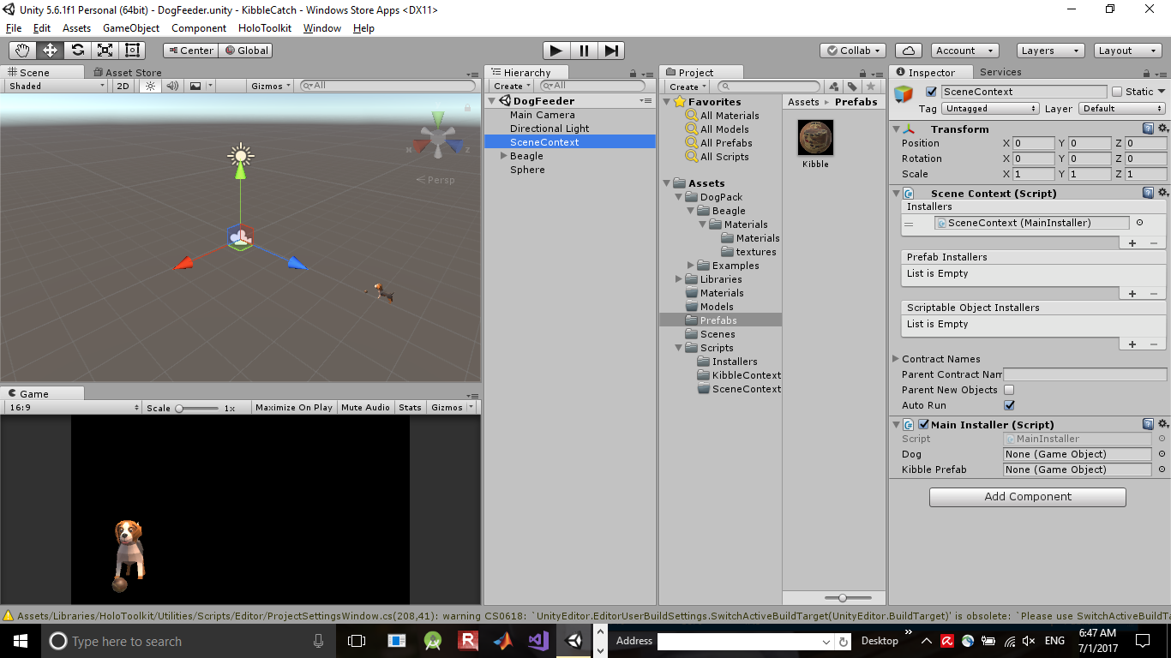
Scene Context
Establish a Scene Context, attach Installer

Slide 15
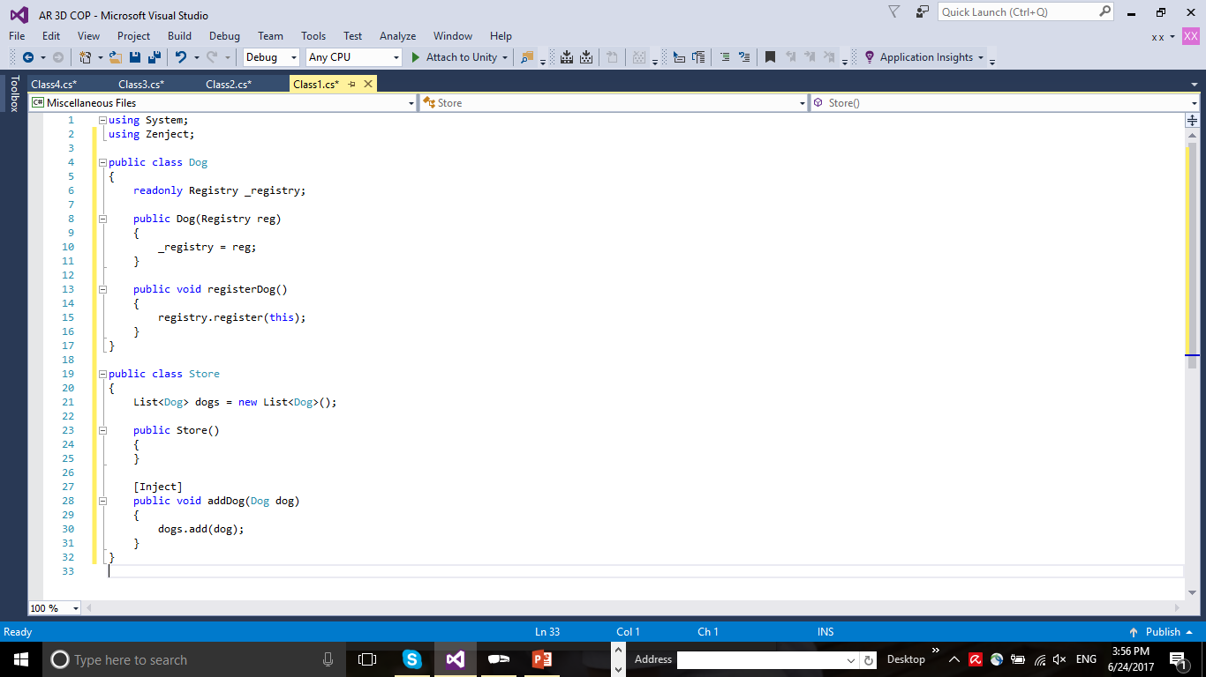
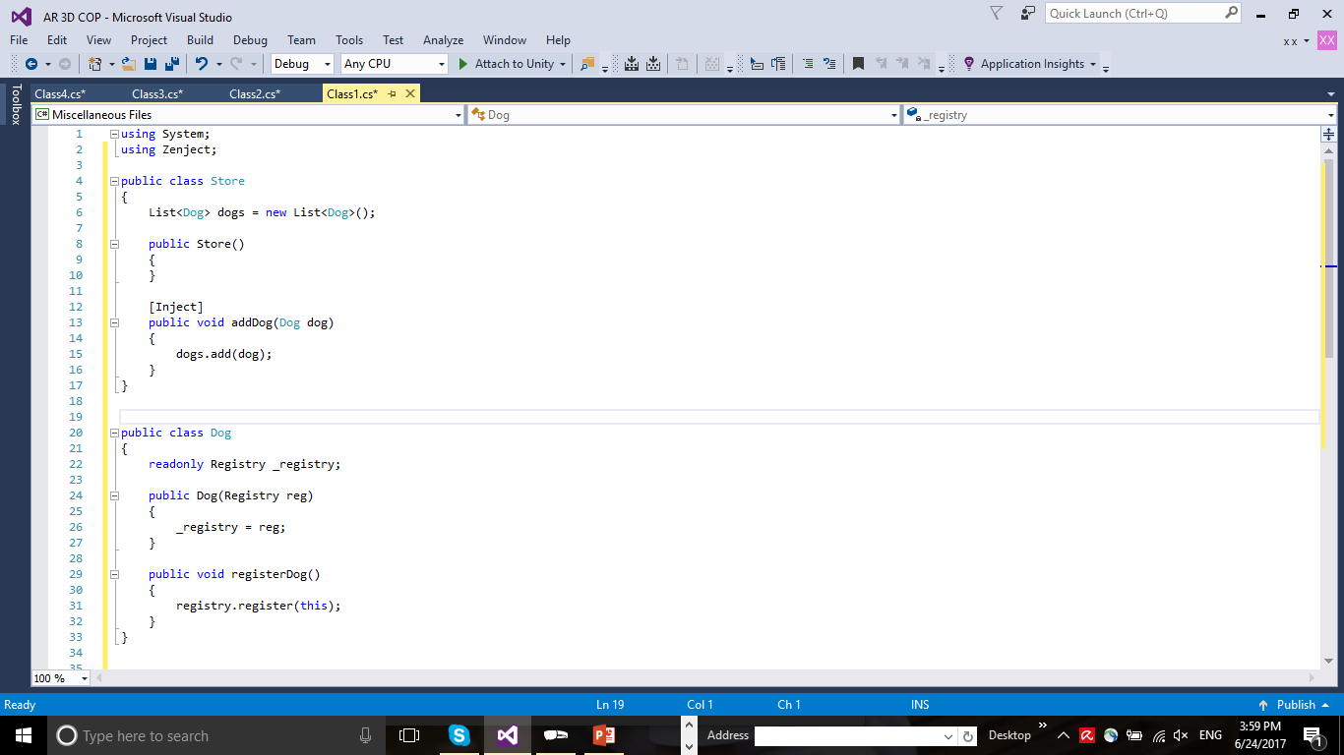
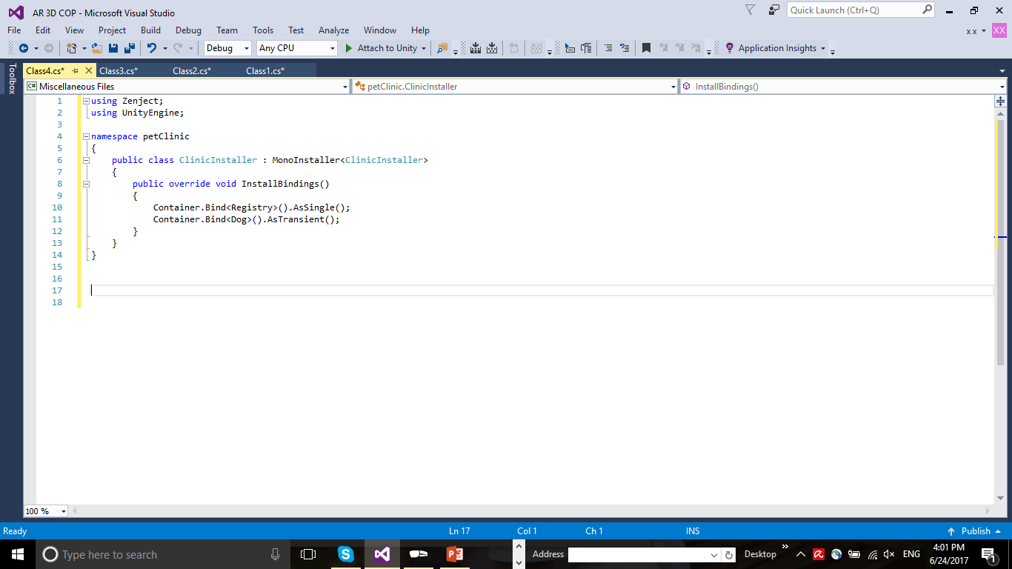
How To Inject
Step 2
Inject your dependency into your class: Objects & Methods

Slide 16
Reminder: MonoBehaviour
Public class Dog : MonoBehaviour
{
void OnStart()
{
}
void Update()
{
}
void OnDestroy()
{
}
}

Slide 17
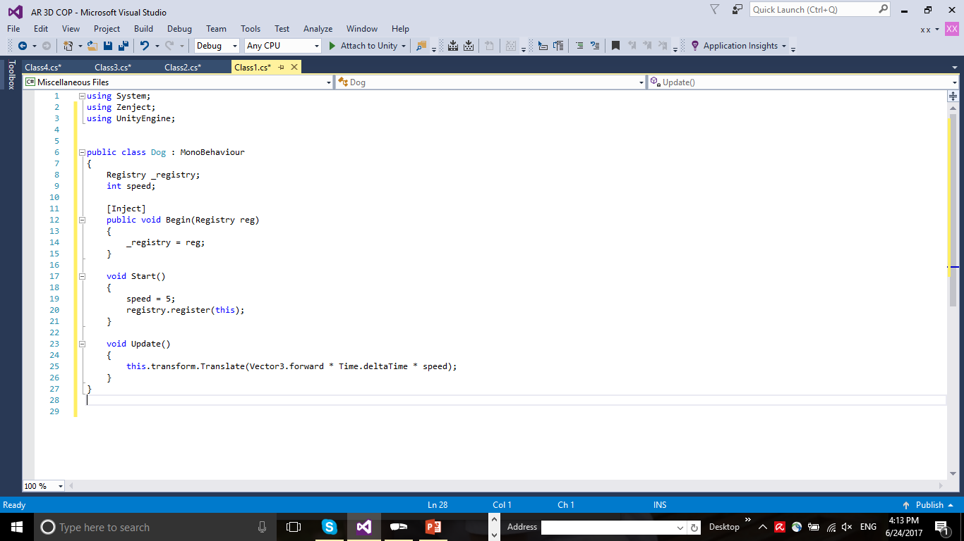
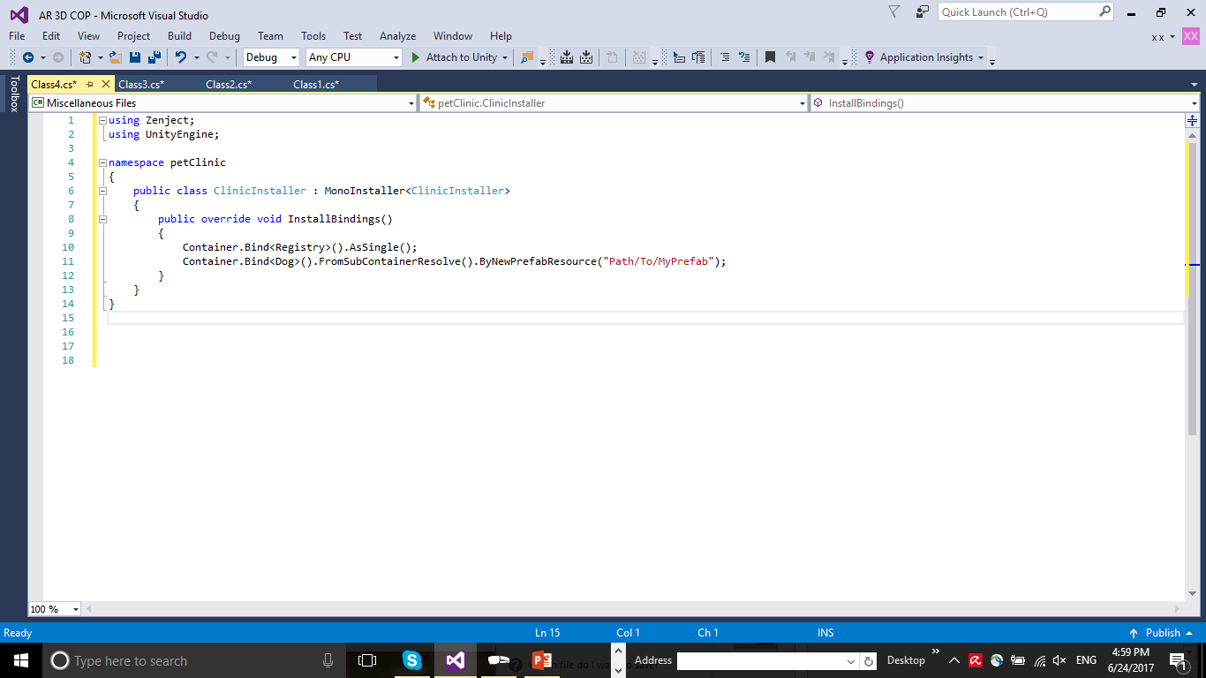
How To Inject
Step 2
Inject your dependency into your class: MonoBehaviour

Slide 18
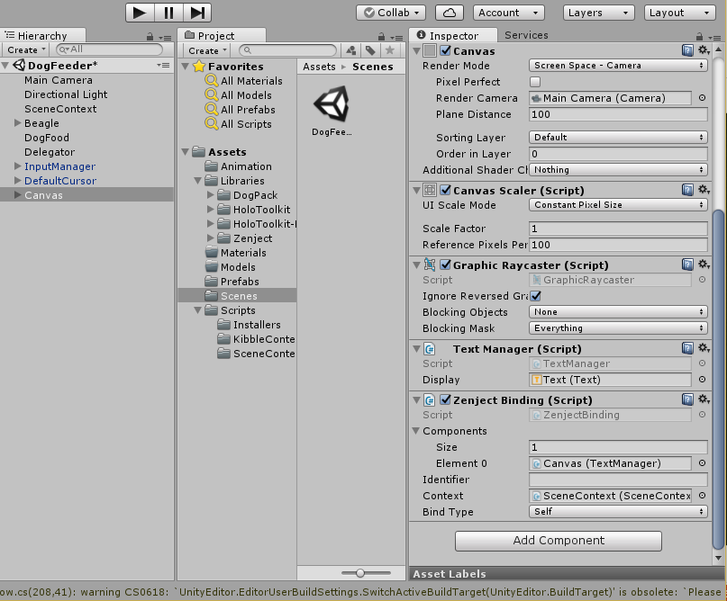
How To Inject
Inject your dependency into your class: MonoBehaviour
Step 2

Slide 19
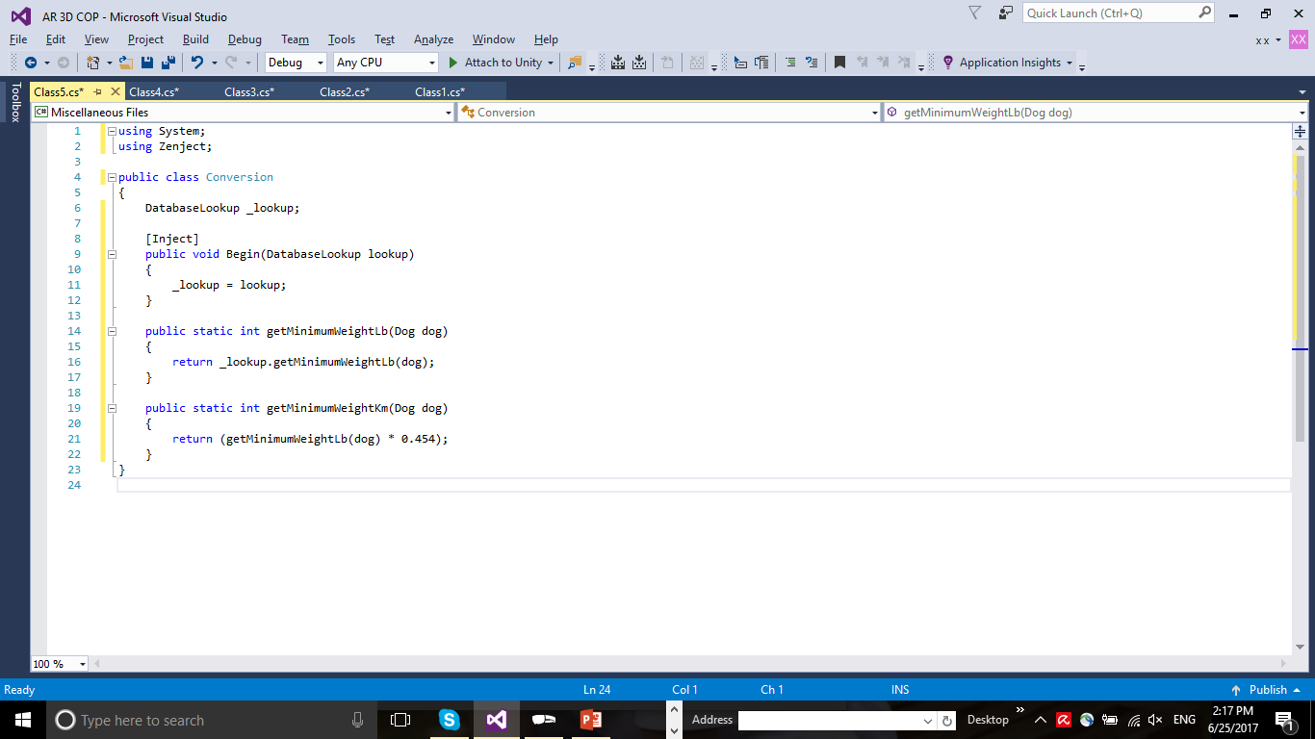
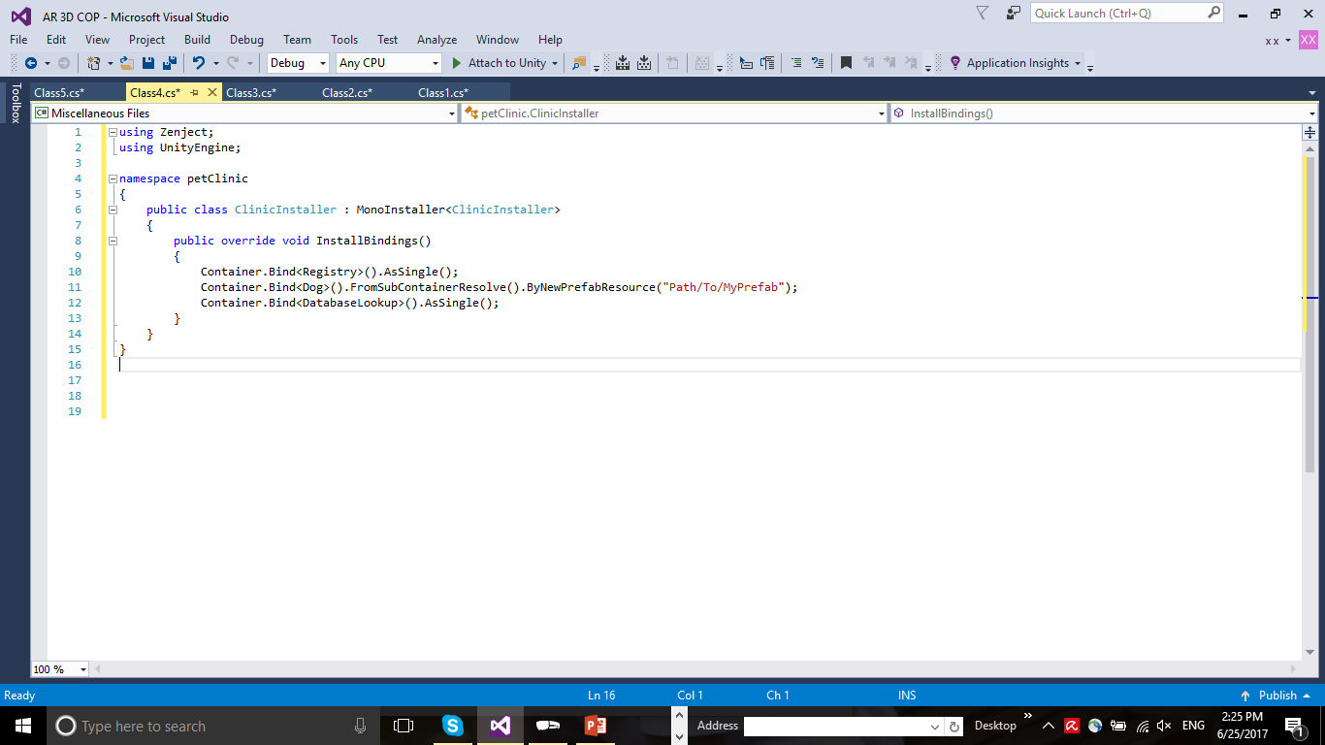
How To Inject
Step 2
Inject your dependency into your class: Supportive Class

Slide 20
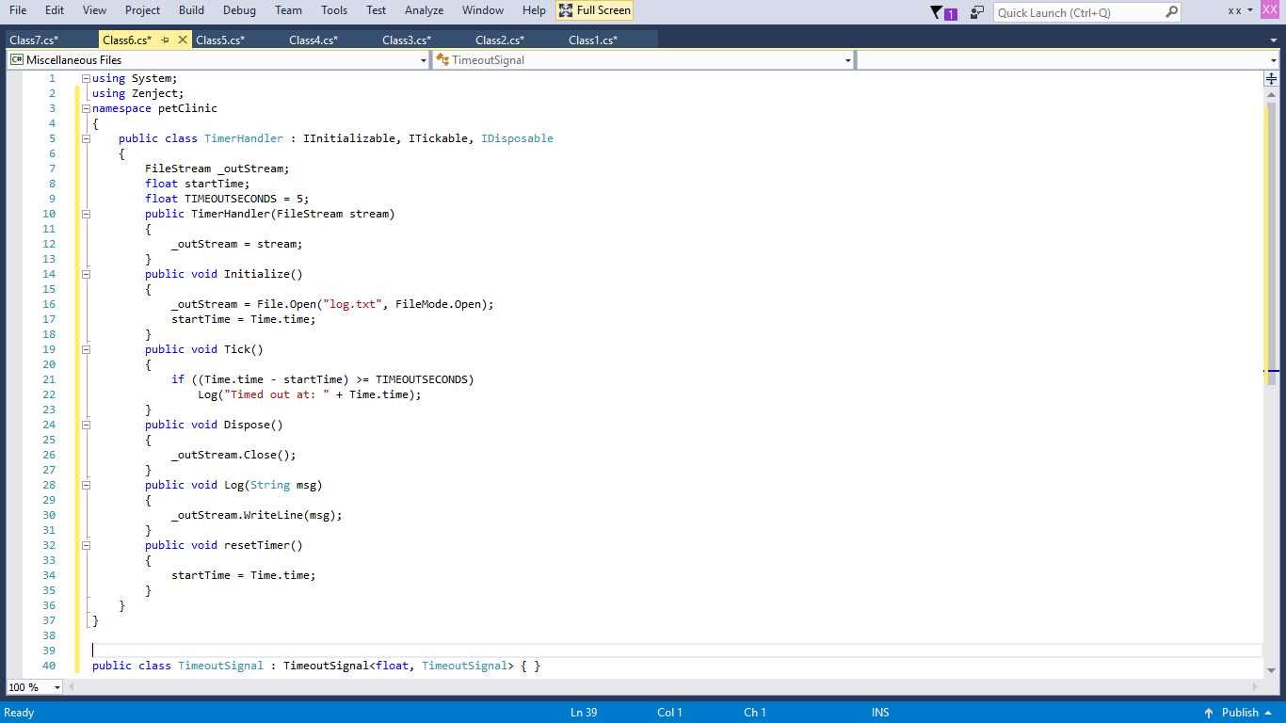
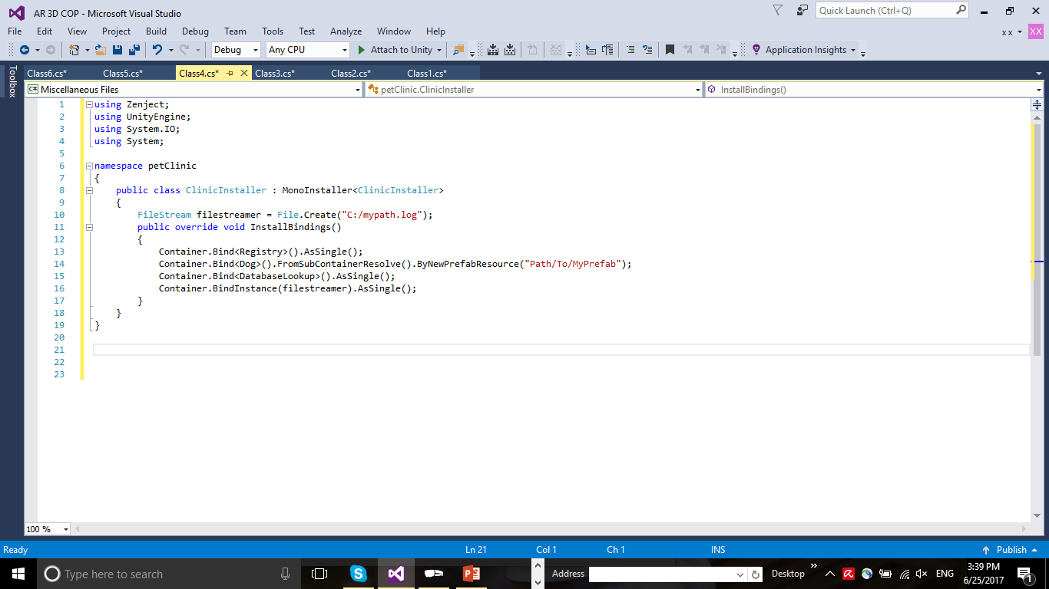

How To Inject
Step 2
Inject your dependency into your class: IInitializable, ITickable, IDisposable

Slide 21
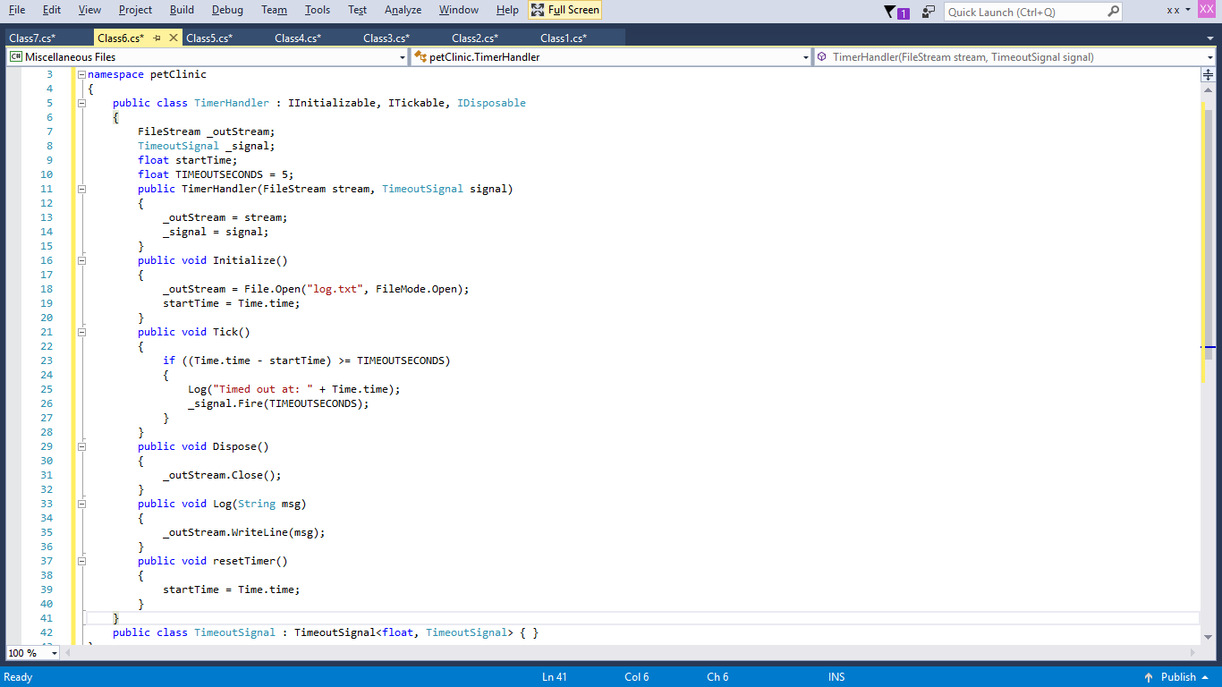
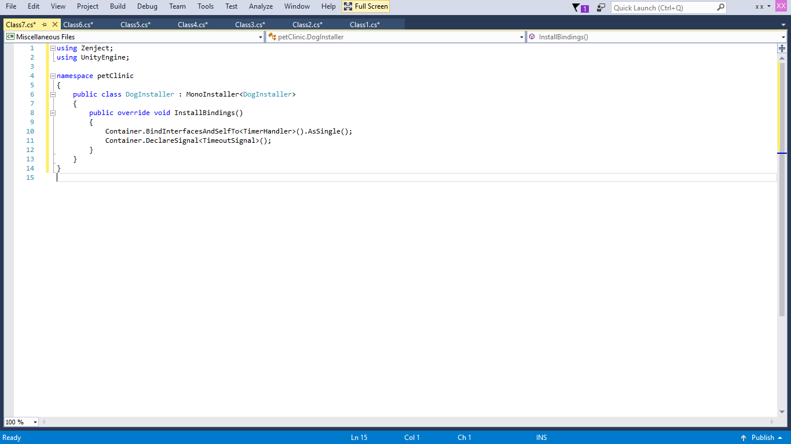
Signals
Allows for communication between classes

Slide 22
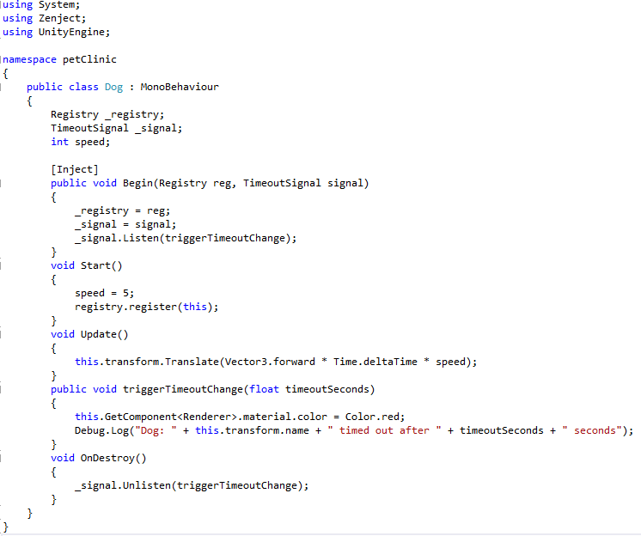
Signals
Allows for communication between classes

Slide 23
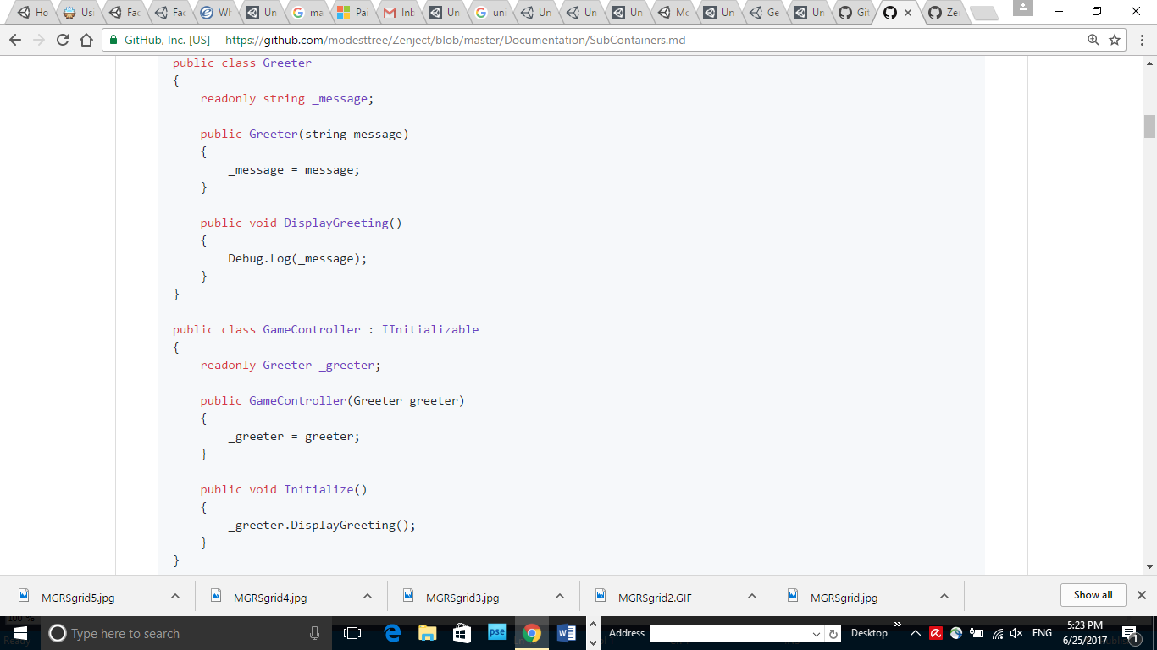
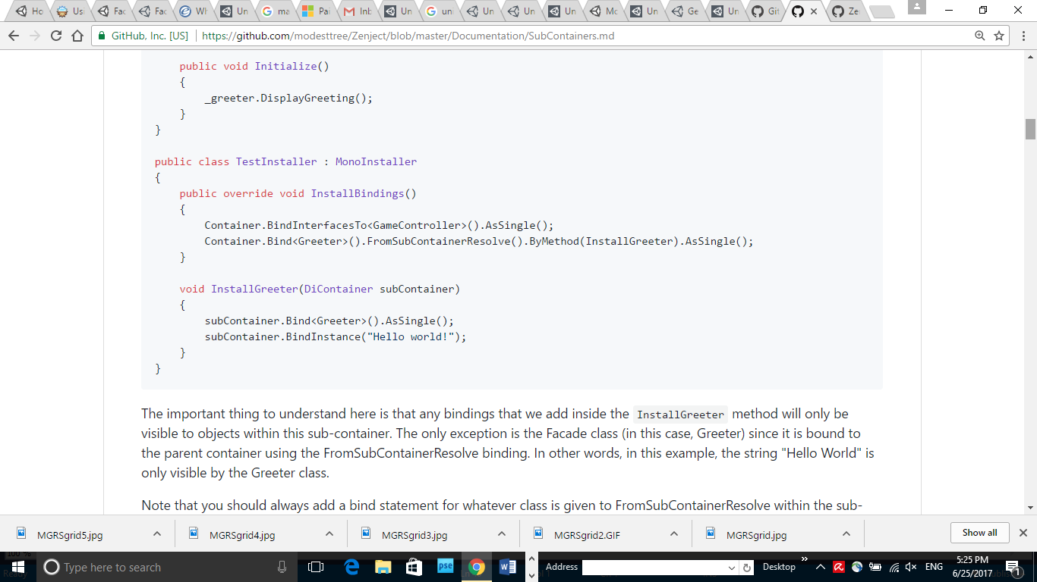
SubContainer
Façade
MonoBehaviour facilitator
Bindings are only visible to other objects in the subcontainer

Slide 24
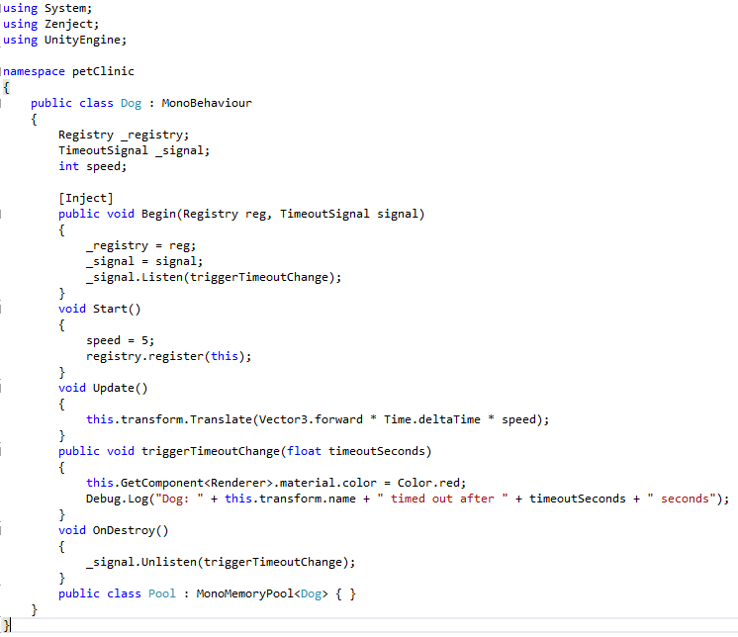
Memory Pool
Provides greater efficiency in creation and destruction

Slide 25
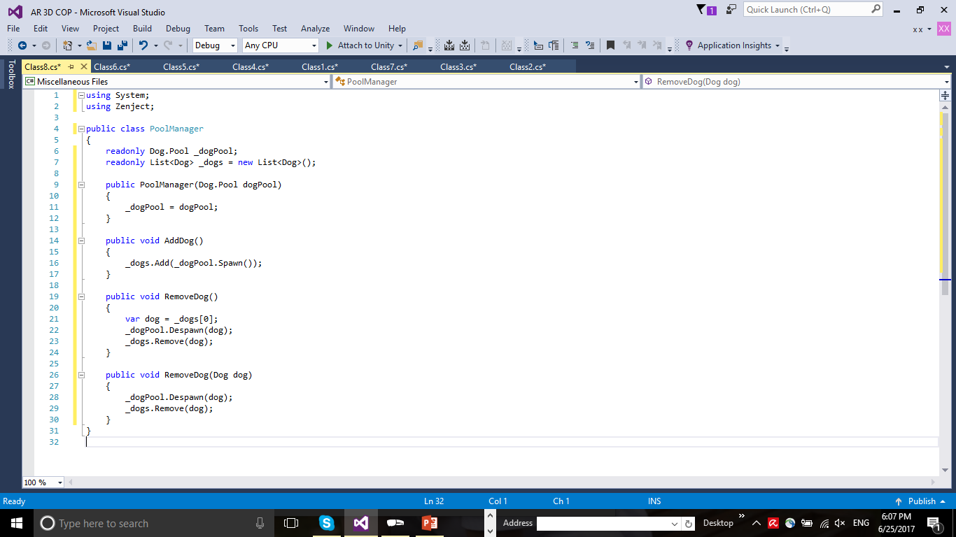
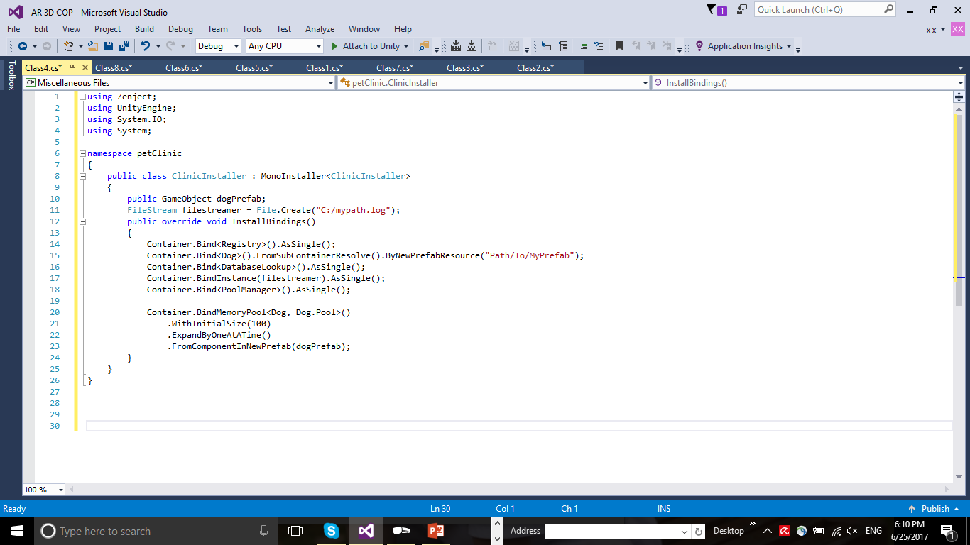
Memory Pool
Provides greater efficiency in creation and destruction

